Slide 1
Chapter 8
Hidden Markov Models

Slide 2


Outline
Basic Definitions
Methods of Speech Recognition
  Dynamic Time Warping
  Hidden Markov Model (HMM)
Three problems for HMM
EM algorithm
Continuous HMM
Practical issues in using HMMs

Slide 3
Basic Definitions(1/4): Conditional Prob. & Bayes’ Rule
S
A
B
AB
P(A|B) is called the conditional probability of event A, given that event B has occurred.
P(A|B) = P(AB) / P(B) = (N_{AB}/N_{S}) / (N_{B}/N_{S})
P(A|B) = P(AB) / P(B) , P(B|A) = P(AB) / P(A)

Slide 4
Basic Definitions(2/4): Conditional Prob. & Bayes’ Rule
The simple version of the chain rule can be derived.
P(AB) = P(A|B)P(B) = P(B|A)P(A)
General chain：
P(A₁A₂…A_{n}) = P(A_{n}|A₁…A_{n-1})…P(A₂|A₁)P(A₁)
If A and B, are independent, then
P(AB) = P(A)P(B)

Slide 5
Basic Definitions(3/4): Conditional Prob. & Bayes’ Rule
A₂
A₃
A₄
B
A₁
A₅
  B= A₁B∪A₂B ∪… ∪A_{n}B
Since A₁B, A₂B, …, A_{n}B are disjoint,
  P(B) = ∑_{k}P(A_{k}B), 1≤k≤n marginal prob. of event B

Slide 6
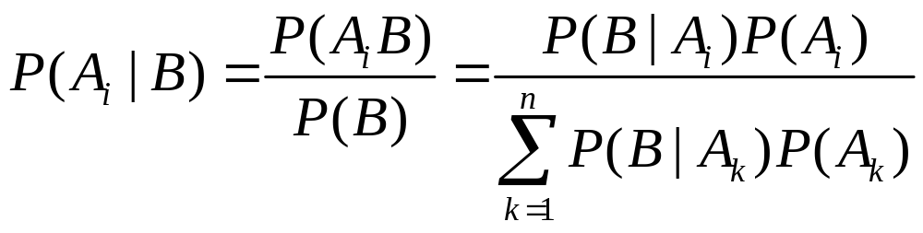
Basic Definitions(4/4): Conditional Prob. & Bayes’ Rule
Bayes’ Rule：

Slide 7
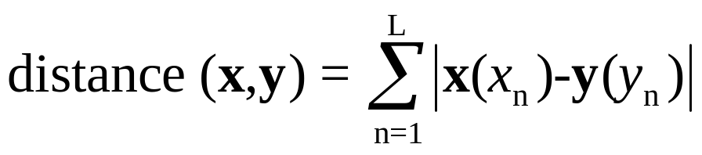
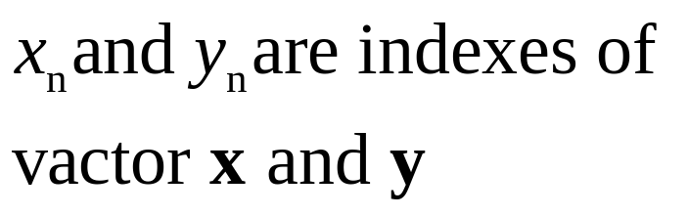
DTW(1/10): Dynamic Time Warping (動態時間校正)
目的：找出兩個向量之間的最短距離
對於兩個 n 維空間中的向量 x 和 y，它們之間的距離可以定義為兩點之間的直線距離 (Euclidean Distance)
但是如果向量的長度不同，那它們之間的距離就無法使用上述的數學式來計算。
  使用DTW計算

Slide 8
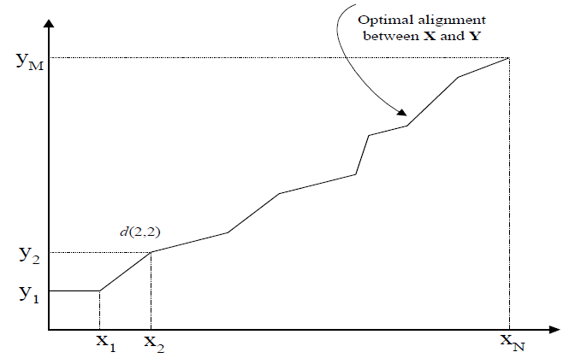
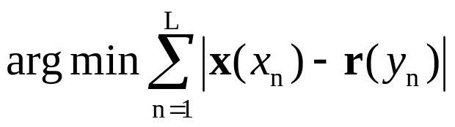

DTW(2/10): Dynamic Time Warping
There are two vectors (x and y), and the length of these two vectors are N and M.
Then to find a path {(x₁,y₁),(x₂,y₂),...(x_{N},y_{M})} which conforms to the condition as follows:
(x₁,y₁) is (1,1)
(x_{L},y_{L}) is (N,M)

Slide 9
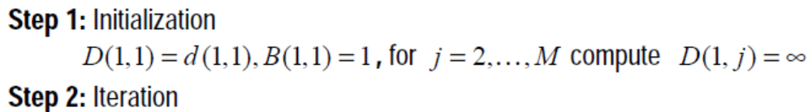
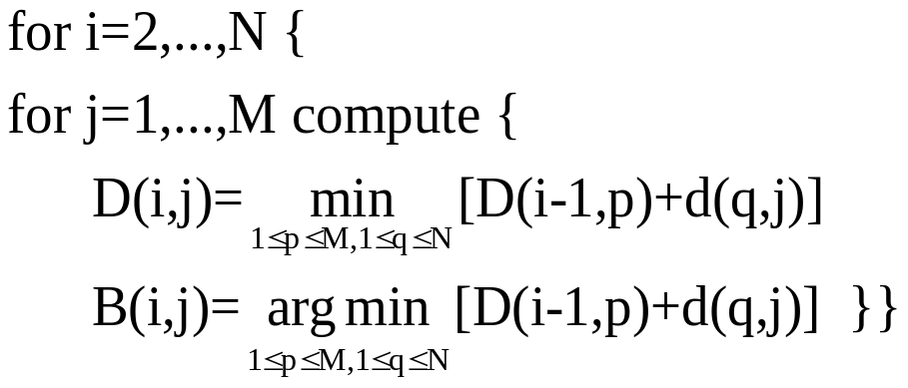
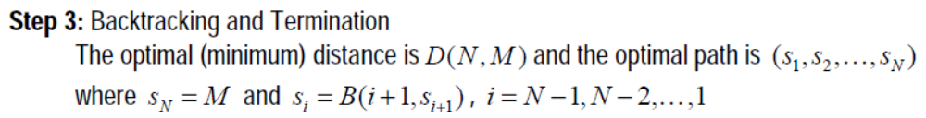
DTW(3/10): DTW algorithm
D(i,j):已經過計算的DTW距離總和
d(i,j):下一點的DTW距離
B(i,j):對每個DTW最小距離累加過程中
所記錄的i和j位置

Slide 10
DTW(4/10): Example of DTW algorithm
Given the two sequences vec1 and vec2 as follows:
How to plot the mapping path by DTW?
fan-in of 0°-45°-90°
fan-in of 27°-45°-63°

Slide 11
DTW(5/10): Example of DTW algorithm (0°-45°-90°)
Step1:計算左邊第一行和下面第一列每一
點之總和(因為每一點路徑只有一種)
Step2:計算左邊第二行所有點的路徑組合
首先根據D(1,1),D(1,2)及D(2,1)計算
出D(2,2)的最小值
j
Step3:再根據D(1,2),D(1,3)和D(2,2)計算出
D(2,3)的最小值
8 7 6 5 4 3 2 1
Step4:再根據D(1,3),D(1,4)和D(2,3)計算出
D(2,4)的最小值
Step5:重複Step4,逐一計算出D(2,5),D(2,6),
D(2,7)和D(2,8)的最小值
Step6:重複Step2~Step4,計算D(3,2),D(3,3),
D(3,4)…D(3,8)的最小值
Step7:最後計算到D(12,8),即得到DTW最小
路徑值
1 2 3 4 5 6 7 8 9 10 11 12
i

Slide 12
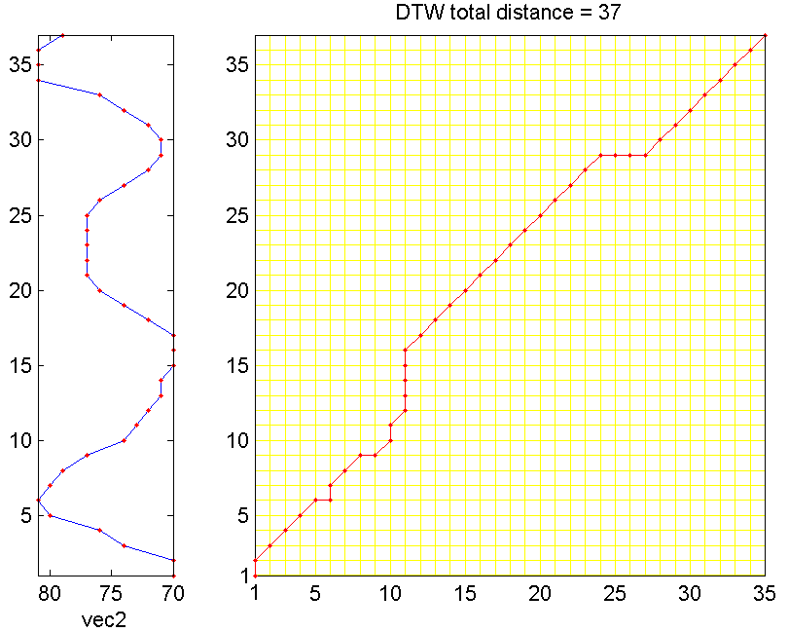
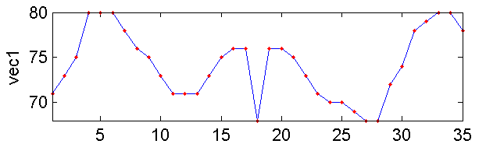
35
fan-in of 0°-45°-90°

Slide 13
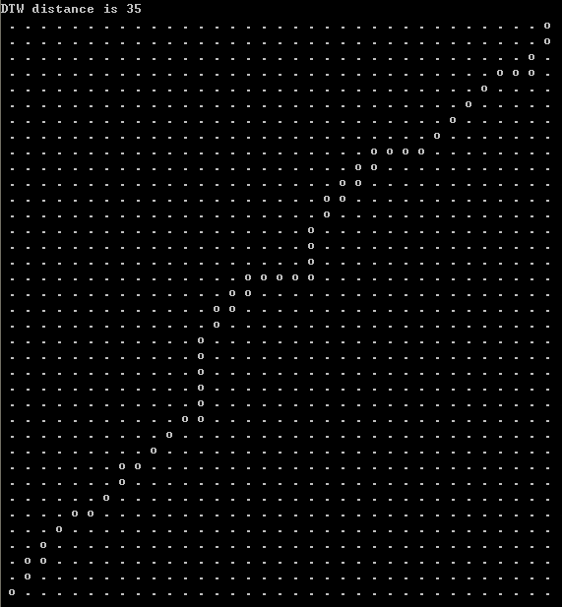
DTW(7/10): Example of DTW algorithm (C code模擬)

Slide 14
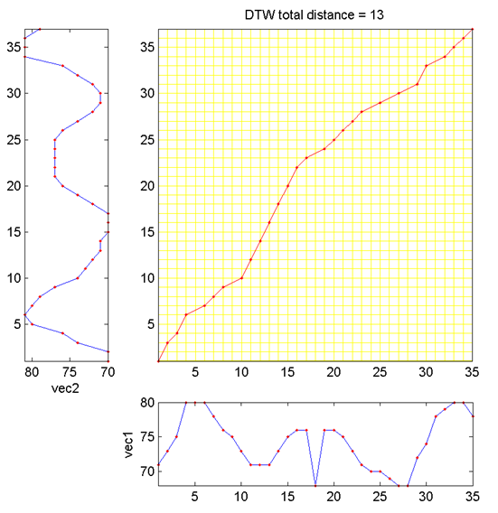
fan-in of 27°-45°-63°

Slide 15
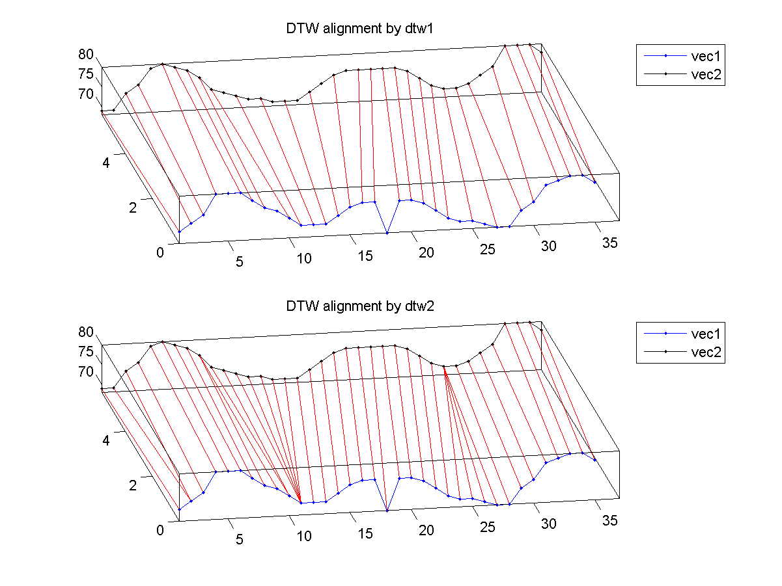
DTW 1
DTW 2

Slide 16
DTW(10/10): Dynamic Time Warping
Pattern-matching-based approach.
Require less computation.
Difficult to achieve speaker independency.
Suitable for small or medium vocabulary recognition.
Suitable for microprocessor implementation.

Slide 17
HMM(1/13): Definition of Markov Chain
HMM is proposed by Vladimir V. Markovnikov in 1870.
For the given information in random process, only the present state will predict the next state.
The previous state has no relationship with the next state.
X(t+1) = f(X(t))
t: state index

Slide 18
HMM(2/13): Markov Assumption
Based on Bayes’ rule:
  P(x₁x₂…x_{n}) = P(x_{n}|x₁…x_{n-1})…P(x₃|x₁x₂)P(x₂|x₁)P(x₁)
Markov assumption:
  P(q|q’) = P(x_{i}=q|x_{i-1}=q’)
  P(x_{n}|x₁…x_{n-1})= P(x_{n}|x_{n-1})
  P(x₁x₂…x_{n}) = P(x_{n}|x_{n-1})…P(x₃|x₂)P(x₂|x₁)P(x₁)

Slide 19
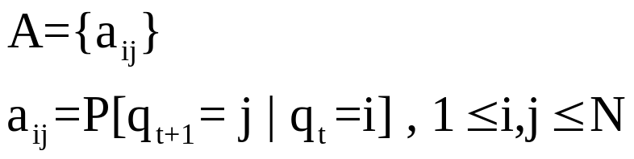
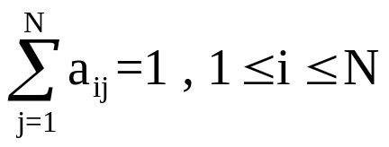

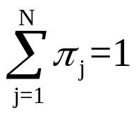
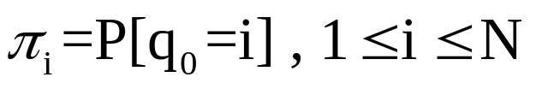
HMM(3/13): Parameters of Markov Model
A : the state-transition probability distribution, we denote as follows:
Π: the probability distribution of the initial state, we denote as follows:

Slide 20
HMM(4/13): Example of Markov Model
Urn 3 (blue balls)
Urn 2 (green balls)
Urn 1 (red balls)
Veil
Observed Ball Sequence

Slide 21
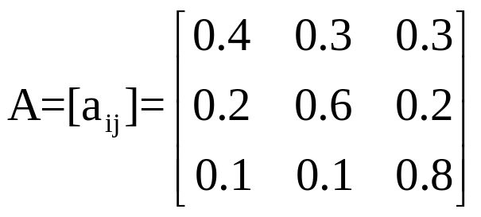
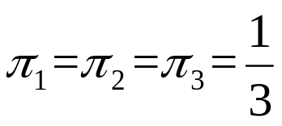
HMM(5/13): Observable Markov Model
We select a particular urn at a given time depends on the urn selected at the previous time.
a₁₁=0.4
Urn 1
a₁₃=0.3
a₂₁=0.2
a₃₁=0.1
a₃₃=0.8
a₁₂=0.3
Urn 3
Urn 2
a₃₂=0.1
a₂₂=0.6
a₂₃=0.2

Slide 22
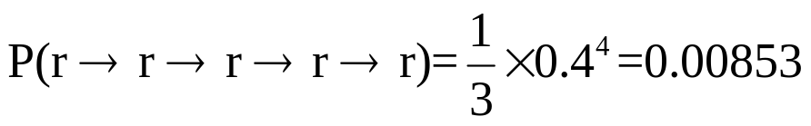
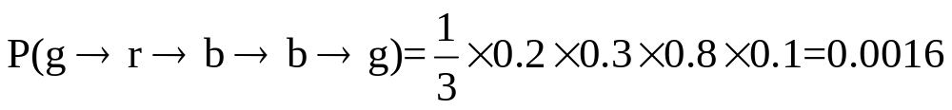
HMM(6/13): Observable Markov Model
Case1:
Case2:
Observed Ball Sequence
Observed Ball Sequence

Slide 23
HMM(7/13): Markov Model
For each state in Markov Model, it is obviously observed.
When the state is hidden or not to observed obviously, it is called the Hidden Markov Model.

Slide 24
HMM(8/13): Example of Hidden Markov Model
Urn 3 (colored)
Urn 2 (colored)
Urn 1 (colored)
Veil
Observed Ball Sequence

Slide 25


HMM(9/13): Example of Hidden Markov Model
Case1:
Case2:
Observed Ball Sequence
Observed Ball Sequence

Slide 26
HMM(10/13): Hidden Markov Model
Q={1,2,...,N}: the set of state.
O=(o₁,o₂,...,o_{T}): the sequence of observation, T means the length of the sequence.
V={1,2,...,M}: the set of observed symbol.

Slide 27


HMM(11/13): Parameters of HMM
A : the state-transition probability distribution.
B : the probability distribution of the observation symbol.
Π : the probability distribution of the initial state.

Slide 28
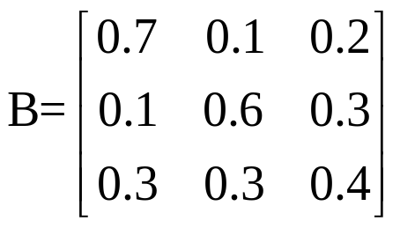
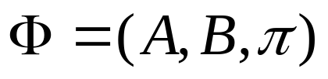
HMM(12/13): Hidden Markov Model
The probability of the colored ball in urn can presented as a matrix B.
The complete parameter set of HMM model is denoted as follows:
r
g
b
0.7
0.1
0.2
0.1
0.6
0.3
0.3
0.3
0.4
urn 1:
=
urn 2:
urn 3:

Slide 29
HMM(13/13): Two assumptions
In the first-order hidden Markov model discussed above, there are two assumptions.
Markov assumption:
P(s_{t}|s₁s₂…s_{t-1})=P(s_{t}|s_{t-1})
Output-independence assumption:
P(x_{t}|x₁x₂…x_{t-1} ,s₁s₂…s_{t})=P(x_{t}|s_{t})

Slide 30
Problems(1/40): Three canonical problems for HMM
The evaluation problem
The decoding problem
The learning problem

Slide 31
Problems(2/40): The Evaluation Problem
Given the initial HMM model Φ=(A,B,Π) and the observation sequence X=(x₁,x₂,...,x_{T}).
How to compute the probability of the observation sequence P(X|Φ).

Slide 32
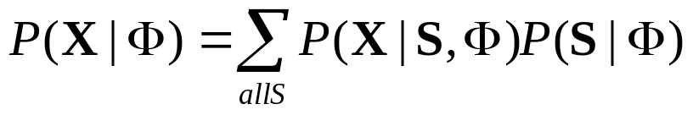
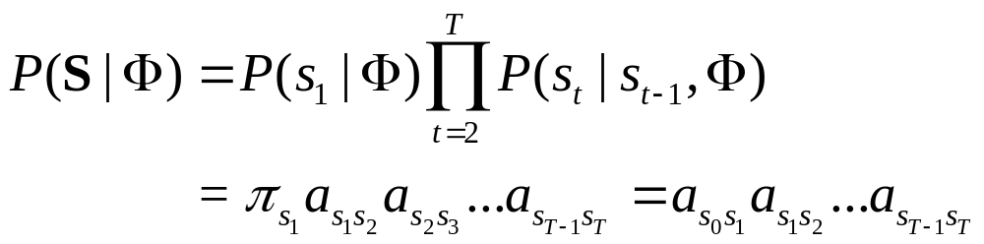
Problems(3/40): How to Evaluate HMM
The most intuitive way is to sum up the probability of all possible state sequence.
For one particular state sequence , the state sequence can be rewritten as follows:
Eq. 8.1
Eq. 8.2

Slide 33
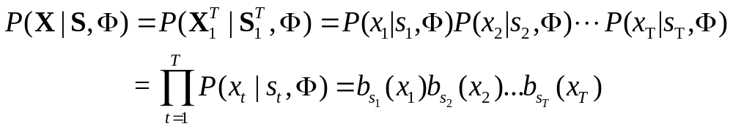
Problems(4/40): How to Evaluate HMM
The joint output probability along the path can be rewritten as follows:
Substituting Eq. 8.2 and Eq. 8.3 into Eq. 8.1.
Eq. 8.3
Eq. 8.2
Eq. 8.4
Complexity: O(N^{T})

Slide 34
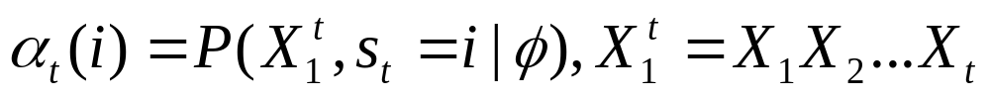
Problems(5/40): The Forward Algorithm
The definition of the forward probability is as follows:
α_{t}(i) is the probability that the HMM is in the state i at the time t, and has the generated partial observation X₁.
Eq. 8.5
t

Slide 35
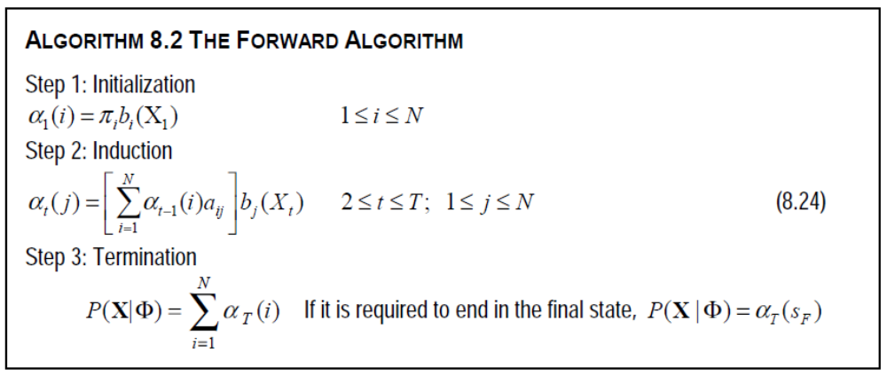


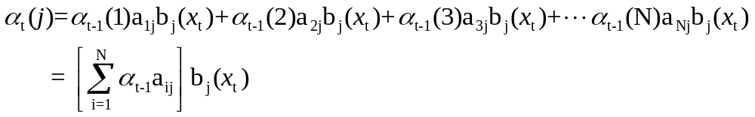
Problems(6/40): The Forward Algorithm
Hint:

Slide 36
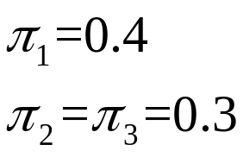
Problems(7/40): Example of Forward Algorithm
Assume that each urn has different colored balls, if the observation sequence X is r-r-r-r-r.
How to compute the probability of the observation sequence P(X|Φ) by forward algorithm?
a₁₁=0.4
Urn 1
a₁₃=0.3
a₂₁=0.2
a₃₁=0.1
a₃₃=0.8
a₁₂=0.3
Urn 3
0.7
0.1
0.2
0.1
0.6
0.3
0.3
0.3
0.4
Urn 2
a₃₂=0.1
urn 1:
urn 2:
urn 3:
a₂₂=0.6
a₂₃=0.2

Slide 37
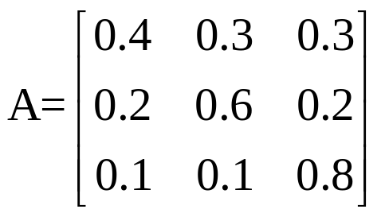
Problems(8/40): Example
π= [0.4 0.3 0.3]
α₃(S1)=(0.0889*0.4+0.0111*0.2+0.0486*0.1)*0.7=0.029848
α₃(S2)=(0.0889*0.3+0.0111*0.6+0.0486*0.1)*0.1=0.003819
α₃(S3)=(0.0889*0.3+0.0111*0.2+0.0486*0.8)*0.3=0.020331
α₅(S1)=(0.0103*0.4+0.0013*0.2+0.0078*0.1)*0.7≒0.0036
α₅(S2)=(0.0103*0.3+0.0013*0.6+0.0078*0.1)*0.1≒0.0004
α₅(S3)=(0.0103*0.3+0.0013*0.2+0.0078*0.8)*0.3≒0.0028
P(X|Φ) ≒ 0.0036+0.0004+0.0028 = 0.0068
α₄(S1)=(0.029848*0.4+0.003819*0.2+0.020331*0.1)*0.7≒0.0103
α₄(S2)=(0.029848*0.3+0.003819*0.6+0.020331*0.1)*0.1≒0.0013
α₄(S3)=(0.029848*0.3+0.003819*0.2+0.020331*0.8)*0.3≒0.0078
α₂(S1)=(0.28*0.4+0.03*0.2+0.09*0.1)*0.7=0.0889
α₂(S2)=(0.28*0.3+0.03*0.6+0.09*0.1)*0.1=0.0111
α₁(S1)=0.4*0.7
α₂(S3)=(0.28*0.3+0.03*0.2+0.09*0.8)*0.3=0.0486
S1
S1
S1
S1
S1
0.28
0.0889
0.029848
0.0103
0.0036
α₁(S2)=0.3*0.1
S2
S2
S2
S2
S2
0.03
0.0111
0.003819
0.0013
0.0004
α₁(S3)=0.3*0.3
S3
S3
S3
S3
S3
0.09
0.0486
0.020331
0.0078
0.0028
t=1
X₁=r
t=2
X₂=r
t=3
X₃=r
t=4
X₄=r
t=5
X₅=r
Complexity: O(N²T)

Slide 38
Problems(9/40): The Decoding Problem
Given the initial HMM model Φ=(A,B,Π) and the observation sequence X=(x₁,x₂,...,x_{T}).
How to choose the most likely state sequence S=(s₁,s₂,...,s_{T}).
Choose the state sequence which has the maximum P(S,X|Φ).

Slide 39
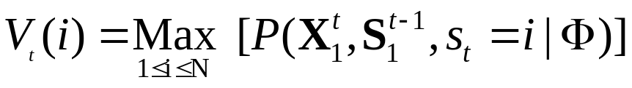
Problems(10/40): How to Decode HMM
The definition of the best-path probability is as follows:
V_{t}(i) is the probability of the most likely state sequence at time t ,which has the generated observation X₁ and ends in state i.
Eq. 8.6
t
Time index
1 …
t-1
t
a_{1i}
1
₁
a_{2i}
State
2
₂
_{i}
a_{Ni}
N
_{N}
Observation
X₁ …
X_{t-1}
X_{t}

Slide 40
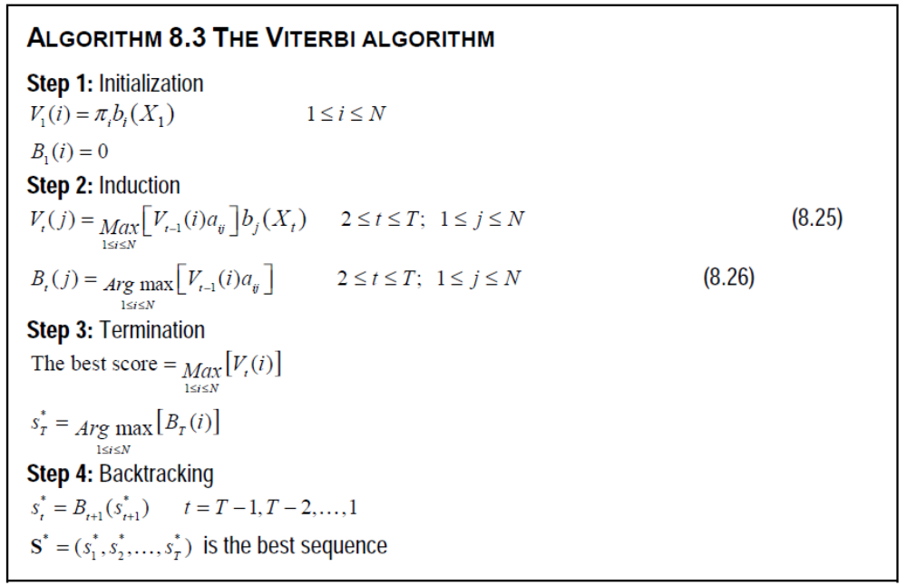
Problems(11/40): The Viterbi Algorithm

Slide 41
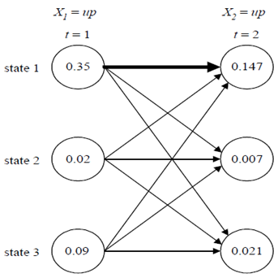
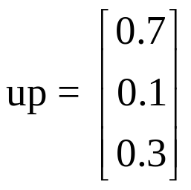

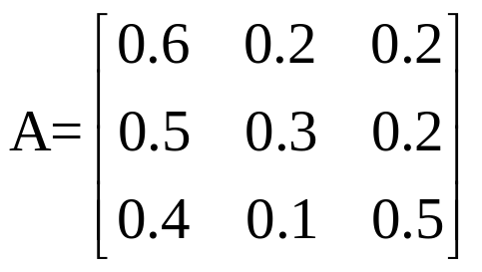
Problems(12/40): Example of Viterbi Algorithm

Slide 42


Problems(13/40): Example of Viterbi Algorithm
0.35*0.6*0.7=0.147
0.02*0.5*0.7=0.007
0.09*0.4*0.7=0.0252
0.35*0.2*0.1=0.007
0.02*0.3*0.1=0.0006
0.09*0.1*0.1=0.0009
0.35*0.2*0.3=0.021
0.02*0.2*0.3=0.012
0.09*0.5*0.3=0.0135

Slide 43
Problems(14/40): The Learning Problem
Given the initial HMM model Φ=(A,B,Π) and the observation sequence X=(x₁,x₂,...,x_{T}).
How to adapt the HMM parameters for the given observation sequence.
Adapt the HMM parameters which has the maximum P(X|Φ).

Slide 44
Problems(15/40): How to Estimate HMM Parameters
It is important to estimate the model parameters Φ=(A,B,Π) to accurately describe the observation sequence.
The problem can be solved by the iterative Baum-Welch algorithm.
It is also known as the forward-backward algorithm.

Slide 45
Problems(16/40): Backward Algorithm
The definition of backward probability is as follows:
Where β_{t}(i) is the probability of generating partial observation X_{t+1} (from t+1 to the end) which the HMM is in state i at time t.
Eq. 8.7
T

Slide 46
Problems(17/40): Forward and Backward Algorithm
Time index
1 …
t-1
t
t+1
… T
a_{1i}
a_{i1}
1
1
a_{2i}
a_{i2}
2
2
a_{3i}
a_{i3}
State
3
i
3
a_{Ni}
a_{iN}
α_{t}(i)
N
N
β_{t}(i)
Observation
X₁ …
X_{t-1}
X_{t}
X_{t+1}
… X_{T}

Slide 47
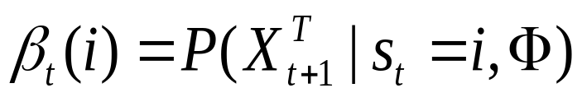
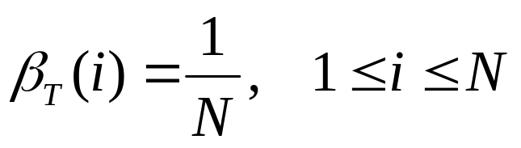
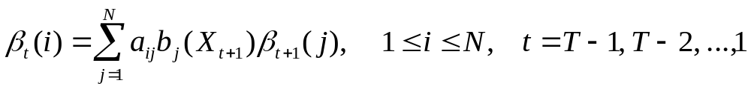
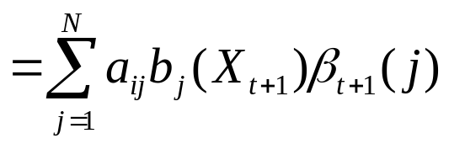
Problems(18/40): Backward Algorithm
Initialization :
Induction :
Eq. 8.8
Eq. 8.9
Hint:

Slide 48
Problems(19/40): Example of Backward Algorithm
Assume that each urn has different colored balls, if the observation sequence X from t=6 to 10 is r-r-r-r-r.
How to compute the probability of the observation sequence P(X|Φ) by backward algorithm?
a₁₁=0.4
Urn 1
a₁₃=0.3
a₂₁=0.2
a₃₁=0.1
a₃₃=0.8
a₁₂=0.3
Urn 3
0.7
0.1
0.2
0.1
0.6
0.3
0.3
0.3
0.4
Urn 2
a₃₂=0.1
urn 1:
urn 2:
urn 3:
a₂₂=0.6
a₂₃=0.2

Slide 49
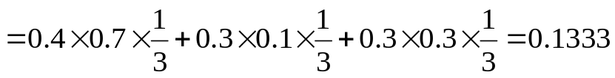
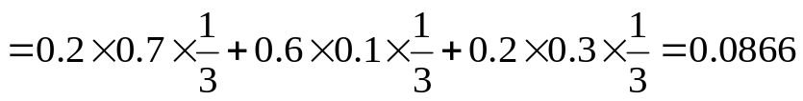
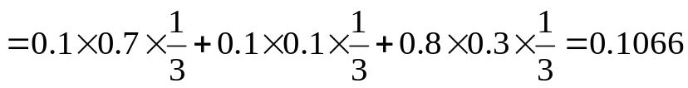
Problems(20/40): Cont.
π= [0.4 0.3 0.3]
P(X|Φ) ≒ 0.0064+0.0038+0.0043=0.0145
S1
S1
S1
S1
S1
0.0064
0.0179
0.0495
β₉(S1)=0.1333
β₁₀(S1)=1/3
β₆(S1)
β₇(S1)
β₈(S1)
S2
S2
S2
S2
S2
0.0038
0.0108
0.0302
β₉(S2)=0.0866
β₁₀(S2)=1/3
β₆(S2)
β₇(S2)
β₈(S2)
S3
S3
S3
S3
S3
0.0043
0.0123
0.0357
β₉(S3)=0.1066
β₁₀(S3)=1/3
β₆(S3)
β₇(S3)
β₈(S3)
t=6
X₆=r
t=7
X₇=r
t=8
X₈=r
t=9
X₉=r
t=10
X₁₀=r

Slide 50
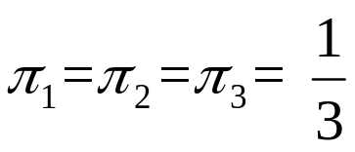
Problems(21/40): Example of Forward Algorithm
Assume that each urn has different colored balls, if the observation sequence X is r-g-b-g-r.
How to compute the probability of the observation sequence P(X|Φ) by forward algorithm?
a₁₁=0.4
Urn 1
a₁₃=0.3
a₂₁=0.2
a₃₁=0.1
a₃₃=0.8
a₁₂=0.3
Urn 3
0.7
0.1
0.2
0.1
0.6
0.3
0.3
0.3
0.4
Urn 2
a₃₂=0.1
urn 1:
urn 2:
urn 3:
a₂₂=0.6
a₂₃=0.2

Slide 51
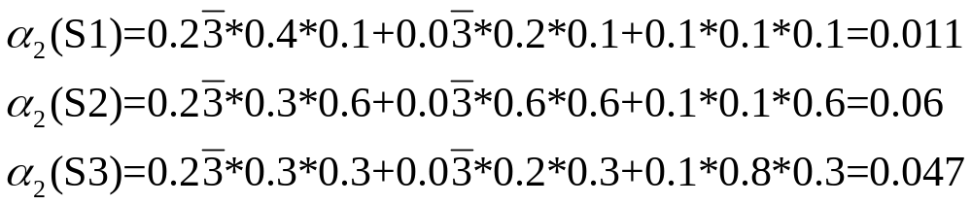
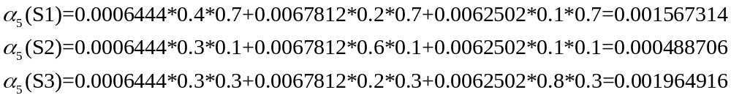
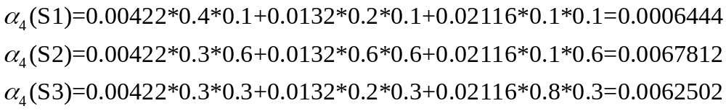
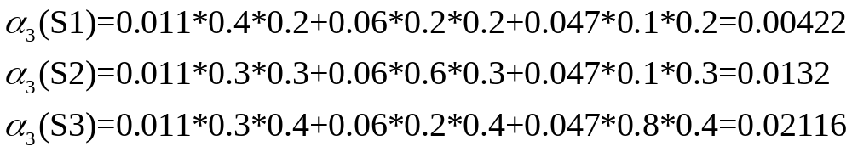
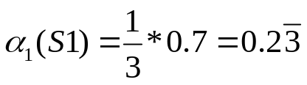





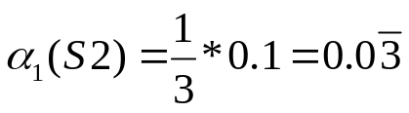












Problems(22/40): Cont.
π= [1/3 1/3 0.3]
S1
S1
S1
S1
S1
S2
S2
S2
S2
S2
S3
S3
S3
S3
S3
t=1
X₁=r
t=2
X₂=g
t=3
X₃=b
t=4
X₄=g
t=5
X₅=r
Complexity: O(N²T)

Slide 52
Problems(23/40): Example of Forward Algorithm
Assume that each urn has different colored balls, if the observation sequence X is r-g-b-g-r.
How to compute the probability of the observation sequence P(X|Φ) by backward algorithm?
a₁₁=0.4
Urn 1
a₁₃=0.3
a₂₁=0.2
a₃₁=0.1
a₃₃=0.8
a₁₂=0.3
Urn 3
0.7
0.1
0.2
0.1
0.6
0.3
0.3
0.3
0.4
Urn 2
a₃₂=0.1
urn 1:
urn 2:
urn 3:
a₂₂=0.6
a₂₃=0.2

Slide 53




















Problems(24/40): Cont.
π= [1/3 1/3 1/3]
S1
S1
S1
S1
S1
S2
S2
S2
S2
S2
S3
S3
S3
S3
S3
t=1
X₁=r
t=2
X₂=g
t=3
X₃=b
t=4
X₄=g
t=5
X₅=r

Slide 54

Problems(25/40): Forward-backward Algorithm
We define γ_{t}(i,j), which is the probability of taking the transition from state i to the state j at time t.
Eq. 8.10

Slide 55

Problems(26/40): Forward-backward Algorithm
Time index
1 …
t-2
t-1
t
t+1
… T
a_{1i}
a_{j1}
1
1
a_{2i}
a_{j2}
2
2
a_{3i}
a_{j3}
3
i
a_{ij}
j
3
a_{Ni}
b_{j}(X_{t})
a_{jN}
α_{t-1}(i)
N
N
β_{t}(j)
Observation
X₁ …
X_{t-2}
X_{t-1}
X_{t}
X_{t+1}
… X_{T}

Slide 56

Problems(27/40): How to Estimate HMM Parameters
_
It is important to adapt the HMM parameters Φ which has the maximum P(X|Φ).
Our goal is to maximize the log-likelihood of the observation.
_
Eq. 8.11

Slide 57
Problems(28/40): EM Algorithm
The name of EM means the expectation and maximization.
For the Expectation-Step, it is used to compute the auxiliary function (Q-function).
For the Maximization-Step, it is used to maximize the Q-function and then to find the optimal parameters.

Slide 58

Problems(29/40): EM Algorithm

Slide 59





Problems(30/40): E-Step - compute
: Expectation of log-likelihood from complete data based on
Bayes rule:
Eq. 8.12
Conditional expectation:

Slide 60





Problems(31/40): E-Step - compute
Eq. 8.13
將 分解成含有a, b參數表示
Eq. 8.14

Slide 61





Problems(32/40): E-Step - compute
Where
Eq. 8.15
The maximization of can be done by maximizing the individual terms separately, subject
to probability constraints:

Slide 62



Problems(33/40): M-Step
Eq. 8.15
probability constraints:
Moreover, eq. 8.15 has the following form:
By using the Lagrange multipliers, the function above can be proved to achieve maximum value at

Slide 63




Problems(34/40): M-Step
probability constraints:
Using this formation , we obtain the model estimate as:

Slide 64






Problems(35/40): adapt π
Eq. 8.10
:只考慮某一個 time index t,其中 time index t 所處在的狀態為 j
而前一個 time index t-1 所處在的狀態為 i,且所觀測到的序列為
Step1:
由於第一個time index t=1且第一個狀態序列為s1,π可視為
Step2:
考慮 time index 為 t 的情況下,所有可能的狀態
Step3:

Slide 65
Problems(36/40): Example of Forward-Backward
Assume that each urn has different colored balls, if the observation sequence X is r-r-r-r-r.
How to adapt the HMM parameters which has the maximum P(X|Φ).
a₁₁=0.4
Urn 1
a₁₃=0.3
a₂₁=0.2
a₃₁=0.1
a₃₃=0.8
a₁₂=0.3
Urn 3
0.7
0.1
0.2
0.1
0.6
0.3
0.3
0.3
0.4
Urn 2
a₃₂=0.1
urn 1:
urn 2:
urn 3:
a₂₂=0.6
a₂₃=0.2

Slide 66
Problems(37/40): Example of Forward-Backward
S1
S1
S1
S1
S1
α₁(S1)
α₂(S1)
α₃(S1)
α₄(S1)
α₅(S1)
0.28
0.0889
0.0298
0.0103
0.0036
β₁(S1)
β₂(S1)
β₃(S1)
β₄(S1)
β₅(S1)
0.0064
0.0179
0.0495
0.1333
0.3333
S2
S2
S2
S2
S2
α₁(S2)
α₂(S2)
α₃(S2)
α₄(S2)
α₅(S2)
0.03
0.0111
0.0038
0.0013
0.0004
β₁(S2)
β₂(S2)
β₃(S2)
β₄(S2)
β₅(S2)
0.0038
0.0108
0.0302
0.0866
0.3333
S3
S3
S3
S3
S3
α₁(S3)
0.09
α₂(S3)
0.0486
α₃(S3)
0.0203
α₄(S3)
0.0078
α₅(S3)
0.0028
β₁(S3)
0.0043
β₂(S3)
0.0123
β₃(S3)
0.0357
β₄(S3)
0.1066
β₅(S3)
0.3333
t=1
X₁=r
t=2
X₂=r
t=3
X₃=r
t=4
X₄=r
t=5
X₅=r

Slide 67




Problems(38/40): Example of Forward-Backward - adapt π

Slide 68

Problems(39/40): Example of Forward-Backward - adapt a, b

Slide 69


Problems(40/40): Example of Forward-Backward - adapt a, b

Slide 70



Example (1/7): Example of Speech Recognition
描述：訓練三個音分別為{甲、丙、丁、辛、癸}，每個音各有10組不同的觀測序列，每個觀測序列長度為7個音框，並且給定初始HMM參數。
問題1：如何藉由觀測序列，調適新的HMM參數。
問題2：調適新的HMM參數後，隨機給定一組觀測序列，如何辨識此觀測序列是哪個音
0.5
0.5
1.0
s₁
0.5
s₂
0.5
s₃
ㄐ
ㄧ
ㄚ
ㄅ
ㄧ
ㄥ
ㄉ
ㄧ
ㄥ
ㄒ
ㄧ
ㄣ
ㄍ
ㄨ
ㄟ

Slide 71
Example (2/7): Example of Speech Recognition
model 甲
int seq01[10][7] = {{0,0,0,0,0,1,2},{0,0,0,0,1,1,2},{0,0,0,1,1,1,2},{0,0,0,1,1,2,2},
{0,0,0,1,2,2,2},{0,0,1,1,1,1,2},{0,0,1,1,1,2,2},{0,0,1,1,2,2,2},{0,1,1,1,2,2,2},{0,1,1,1,1,2,2}}
Example:
{0,0,0,0,0,1,2} = {ㄐㄐㄐㄐㄐㄧㄚ}
{0,0,0,0,1,1,2} = {ㄐㄐㄐㄐㄐㄧㄧㄚ}
一組觀測序列會產生7*3=21組α值及β值,以及3*3*7=63組γ值
因此十組觀測序列會產生210組α值及β值,以及630組γ值,
再藉由這些龐大資料去調適新的HMM參數

Slide 72

Example (3/7): Example of Speech Recognition
model 甲
original:
adaptive:

Slide 73

Example (4/7): Example of Speech Recognition
model 丙
int seq01[10][7] = {{0,0,0,0,1,1,2},{0,0,0,0,1,2,2},{0,0,1,1,1,1,2},{0,1,1,1,1,2,2},
{0,0,1,1,2,2,2},{0,0,1,1,1,2,2},{0,1,1,1,2,2,2},{0,0,1,1,2,2,2},{0,1,2,2,2,2,2},{0,1,1,1,1,1,2}};
original:
adaptive:

Slide 74

Example (5/7): Example of Speech Recognition
model 丁
int seq01[10][7] = {{0,0,0,1,1,1,2},{0,0,1,1,1,1,2},{0,0,0,1,2,2,2},{0,0,0,1,1,2,2},
{0,0,0,1,1,1,2},{0,1,1,1,1,1,2},{0,0,1,2,2,2,2},{0,0,1,1,2,2,2},{0,1,1,1,2,2,2},{0,1,1,1,1,2,2}};
original:
adaptive:

Slide 75

Example (6/7): Example of Speech Recognition
model 辛
int seq01[10][7] = {{0,0,1,1,1,1,2},{0,0,1,1,1,1,2},{0,1,2,2,2,2,2},{0,0,0,1,1,2,2},
{0,0,0,1,1,2,2},{0,1,1,2,2,2,2},{0,0,1,2,2,2,2},{0,0,1,1,2,2,2},{0,1,1,1,2,2,2},{0,1,1,1,1,1,2}};
original:
adaptive:

Slide 76

Example (7/7): Example of Speech Recognition
model 癸
int seq01[10][7] = {{0,0,0,1,1,2,2},{0,1,1,1,1,1,2},{0,1,1,1,2,2,2},{0,0,0,1,1,2,2},
{0,0,0,1,1,1,2},{0,1,1,2,2,2,2},{0,1,1,2,2,2,2},{0,0,1,1,2,2,2},{0,1,1,1,2,2,2},{0,1,1,1,1,2,2}};
original:
adaptive:

Slide 77



Continuous HMM (1/8)
The difference from discrete HMM is the observation composed of a continuous space.
Time index
1 …
t-1
t
t+1
… T
1
1
1
1
2
2
2
2
State
3
3
3
3
N
N
N
N
Observation
…
…
probability density
function b_{j}(x)

Slide 78



Continuous HMM (2/8)
Gaussian mixture density functions:
  It can approximate any continuous probability density function.
With M Gaussian mixture distribution, the continuous output probability density function is as follows:
The b_{jk}(x) is a single Gaussian distribution with mean (μ_{jk}) and covariance matrix (Σ_{jk}) for state j, M denotes the number of mixture-components.
The c_{jk} is a weight for K-th mixture in state j.
Eq. 8.18

Slide 79

Continuous HMM (3/8): E-Step - compute
The probability of a sequent observation in a certain state sequence is as follows:
Eq. 8.19 can be considered as the summation of density with all the possible state sequences S and all the possible mixture components K.
Eq. 8.19

Slide 80

Continuous HMM (4/8): E-Step - compute
Define Ω^{T} as the T_{th} Cartesian product of Ω^{T}={1,2,...,M} as follows:
Example of Cartesian product
Eq. 8.20
set D₁: {1,2,3}
D₁ x D₂: {1,A},{1,B},{2,A},{2,B},{3,A},{3,B}
set D₂: {A,B}

Slide 81






Continuous HMM (5/8): E-Step - compute
Therefore, the joint probability density is
An auxiliary function of two model points, and , given an observation X, can be written as:
The following decomposition can be shown:
Eq. 8.21
Eq. 8.22
Eq. 8.23

Slide 82



Continuous HMM (6/8): E-Step - compute
The auxiliary function can be rewritten in a separated form:
This separated form is similar to what is discussed in the discrete HMM, the only difference we have is:
Eq. 8.24
Eq. 8.25
Eq. 8.26

Slide 83






Continuous HMM (7/8): M-Step
Maximization of with respect to is obtained through differentiation with respect to that satisfies:
The solutions are:
Eq. 8.27
Eq. 8.28
Eq. 8.29

Slide 84


Continuous HMM (8/8): The EM Algorithm-M Step
Where
Eq. 8.30
Eq. 8.31

Slide 85



Semi-continuous HMM (1/3)
Where o_{k} is the k_{th} codeword , b_{j}(k) is the same output probability distribution in the discrete HMM or the mixture weights for the continuous mixture density function.
This is a combination of discrete model-dependent weighting coefficients with the continuous codebook probability density functions.
Eq. 8.32
Values of continuous probability density function for all the codewords o_{k}
VQ codebook density function

Slide 86



Evaluation of Semi-continuous HMM (2/3)
We can use compute the posterior probability for each codeword from as defined in follows:
The re-estimation formulas for the tied mixture can be written as:
Eq. 8.33
Eq. 8.34
Eq. 8.35

Slide 87
Comparison of HMMs (3/3)
離散HMM (Discrete HMM, DHMM)其輸出概率是一套碼本的離散概率分布，優點為儲存量和計算量小，所需的訓練語音也較少，但其量化的過程會造成誤差。
連續HMM (Continuous Density HMM, CDHMM)其輸出概率是連續概率密度函數，且一般是高斯混合密度函數，所需的訓練語音較多，模型參數儲存量和計算量較大，其成果優於DHMM。
半連續HMM (Semi-Continuous HMM, SCHMM)可說是DHMM以及CDHMM的折衷，與DHMM相似，其輸出為一套碼本，但每個碼字均為一個連續概率密度分布函數，這一點與CDHMM相近，其成果和所需的訓練語音等均介於DHMM和CDHMM之間。

Slide 88


Example of Gaussian Mixture Model (1/12)
高斯混合模型(Gaussian mixture model, GMM)為單一高斯機率密度函數的延伸，由於GMM能夠平滑地近似任意形狀的密度分布,因此常被用在語音與語者辨識方面
假設我們有若干組d維空間的點在這若干組特徵向量中，一個多維高斯分佈定義如下：
  特徵向量中各分量皆為獨立事件
  通常假設各個高斯密度函數的共變異矩陣可以表示為

Slide 89


Example of Gaussian Mixture Model (2/12)
高斯混合模型Gaussian Mixture Model）
μ₁
μ₂
μ₃

Slide 90

Example of Gaussian Mixture Model (3/12)
假設某市區出現某一疾病，此疾病與人體體重有關係，因此衛生局分別紀錄50位幼童與學童(1-20歲)、成人(20-60歲)，以及老人(60歲以上)的體重，用於判斷某疾病對於國人體重的關聯性，所紀錄的平均值及變異數如下：
類別(x) | 平均值(μ) | 變異數(σ²)
幼童與學童 | 30.8 | 168.36
成人 | 67.78 | 71.97
老人 | 64.02 | 36.21

Slide 91
Example of Gaussian Mixture Model (4/12)
假設某疾病與國人體重的分布有關
  將此疾病觀測機率表示成三種年齡層型態的高斯混合模型
問題：
  如何調適每種高斯模型的平均值、變異數以及權重，使得此疾病的觀測機率為最大值

Slide 92

Example of Gaussian Mixture Model (5/12)
各個高斯分布模型(幼童與學童、成人、老人)，如何調適每個模型之平均值、變異數以及權重
  使用偏微以及Lagrange求法找出極值所在
  採用MLE (maximum likelihood estimate)

Slide 93


Example of Gaussian Mixture Model (6/12)
為簡化討論，我們引進另一個數學符號：
  β_{j}(x)稱為事後機率

Slide 94



Example of Gaussian Mixture Model (7/12)
我們針對μ以及σ進行偏微：
令上兩式為0，可得到：

Slide 95



Example of Gaussian Mixture Model (8/12)
接著再針對權重值進行微分，但因權重值總合須為1
  使用Lagrange Multiplier

Slide 96



Example of Gaussian Mixture Model (9/12)
藉由調適後的參數值進行疊代，找出觀測機率最大值

Slide 97

Example of Gaussian Mixture Model (10/12)
假設一開始權重值各為1/3
類別(x) | 平均值(μ) | 變異數(σ²)
幼童與學童 | 30.8 | 168.36
成人 | 67.78 | 71.97
老人 | 64.02 | 36.22

Slide 98

Example of Gaussian Mixture Model (11/12)
根據公式可找出調適後各年齡層的平均值、變異數以及權重值，再以調適後的參數代入原本參數值進行疊代運算，直到各參數調適後，與前一次參數的差值小於原先所設定門檻值即可停止運算

Slide 99

Example of Gaussian Mixture Model (12/12)
假設門檻值設為這九個參數的差值總合，當差值總合小於0.5時則停止疊代運算
  右圖為最後計算結果

Slide 100
Hidden Markov Model
Statistics-based approach.
Require more computation.
Can achieve speaker independency.
Suitable for large vocabulary.
Difficult for microprocessor or chip implementation.

